Slide 1

Futurense
Democratizing Tech Talent to deliver impact at scale
Sai Prathap - FT755
Siddhesh - FT761
Jachinn - FT744
Sanjyot - FT759
Nikitha - FT767

Slide 2
Healthcare Project

Slide 3
Overview:
Brief Description:
Our SQL project offers data-driven healthcare insights by analyzing patient records, treatment data, and insurance claims. Through efficient SQL queries, we unlock valuable information for informed decision-making and improved patient care.
Business Problem:
In healthcare, making strategic decisions without data insights can lead to inefficiencies in patient care and resource allocation. Extracting meaningful patterns from complex patient data and treatment records poses a challenge.
Solution Approach:
We address this challenge by using SQL to integrate and analyze data, enabling us to uncover trends, correlations, and opportunities. Our optimized queries provide actionable insights, guiding healthcare decisions and optimizing resources for enhanced patient outcomes.

Slide 4
Tools and Technologies Used:
MYSQL Workbench
Data Grip
DBeaver

Slide 5
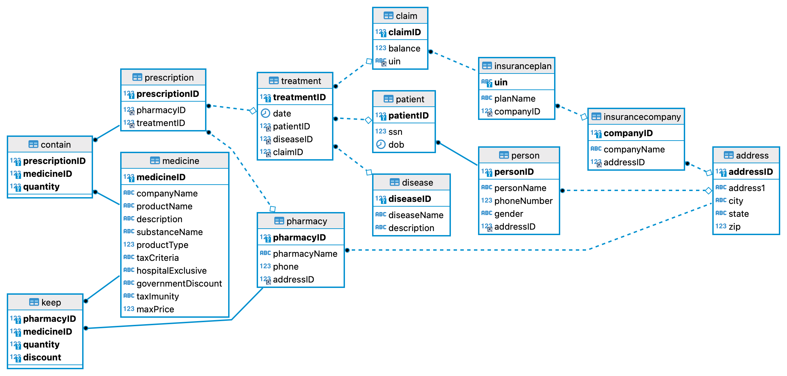
Relevant Diagram/s:

Slide 6
Roadblocks & Resolutions
1. Used IGNORE INTO while Inserting the Data to insert duplicate data
2. Set various necessary Constraints while Creating the Tables
- Duplicate Data while Inserting Values in tables
- Constraints not given in Database

Slide 7
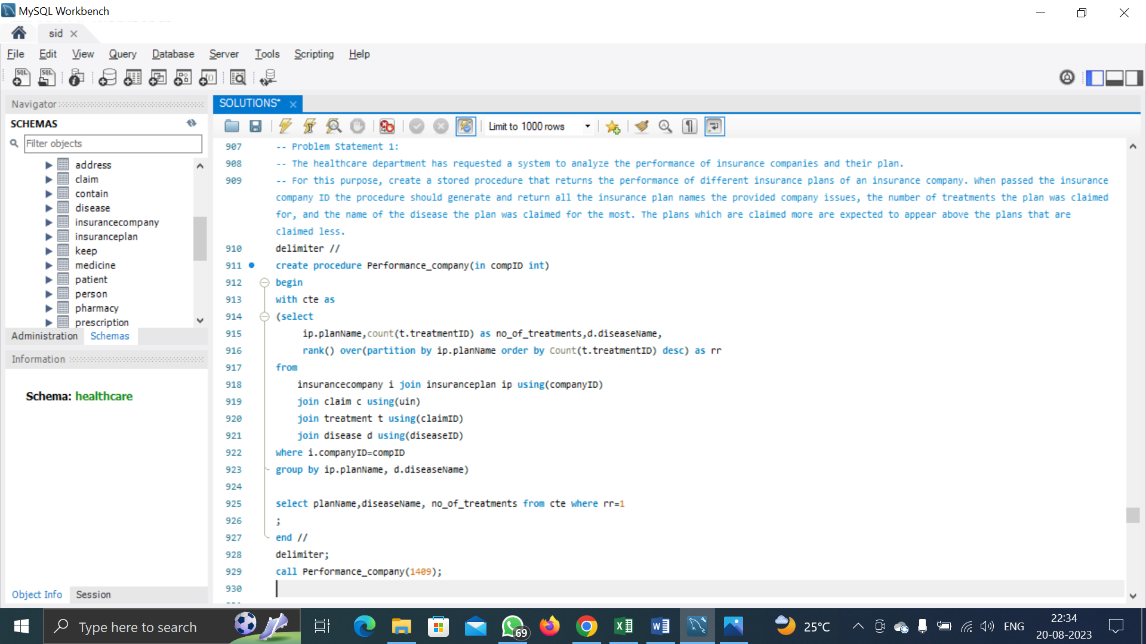
Headline Statistics
(1/2):
Average Execution Time: 15 ms
Wakatime Metrics:
Total Coding Time: 10 mins
Daily Coding Activity: 4 hrs
Most Active Time: 11 pm to 1 am
Top Files and Languages: Healthcare.sql(SQL)
Lines of Code (LoC/KLoC): 19 lines
Total Number of Functions: 3
Number of User-defined Procedure Used: 1
Avg. Number of Lines per Function: 5-6 lines

Slide 8
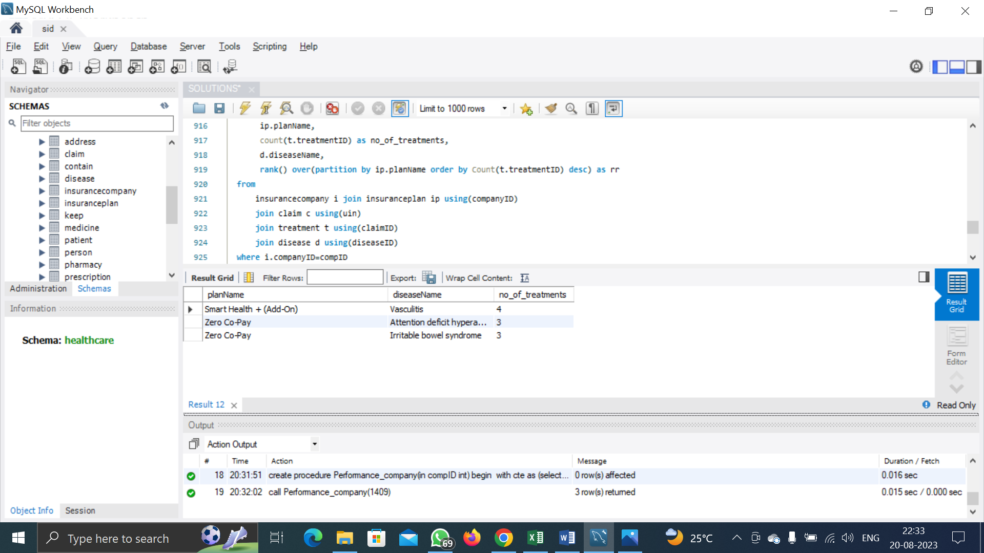
Headline Statistics
(2/2):
Number of comments written: 2 comments
IDE/Code Editor Used: SQL Workbench
Plugins Used: None
Function/Complexity breakdown:
Simple Implementations: Basic tasks like counting
Intermediate Implementations: Using CTE instead sub query
Complex Implementations: grouping data and window function for filtering data

Slide 9
Brian, the healthcare department, has requested for a report that shows for each state how many people underwent treatment for the disease “Autism”. He expects the report to show the data for each state as well as each gender and for each state and gender combination. Prepare a report for Brian for his requirement.

Slide 10
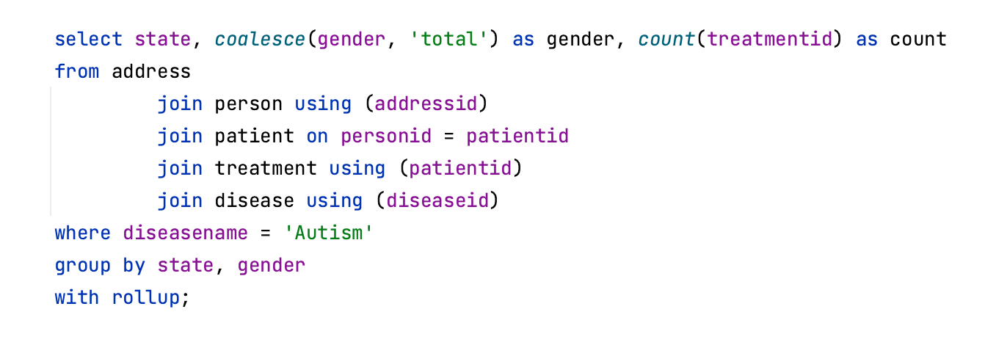

Slide 11
The representative of the pharma union, Aubrey, has requested a system that she can use to find how many people in a specific city have been treated for a specific disease in a specific year. Create a stored function for this purpose.

Slide 12
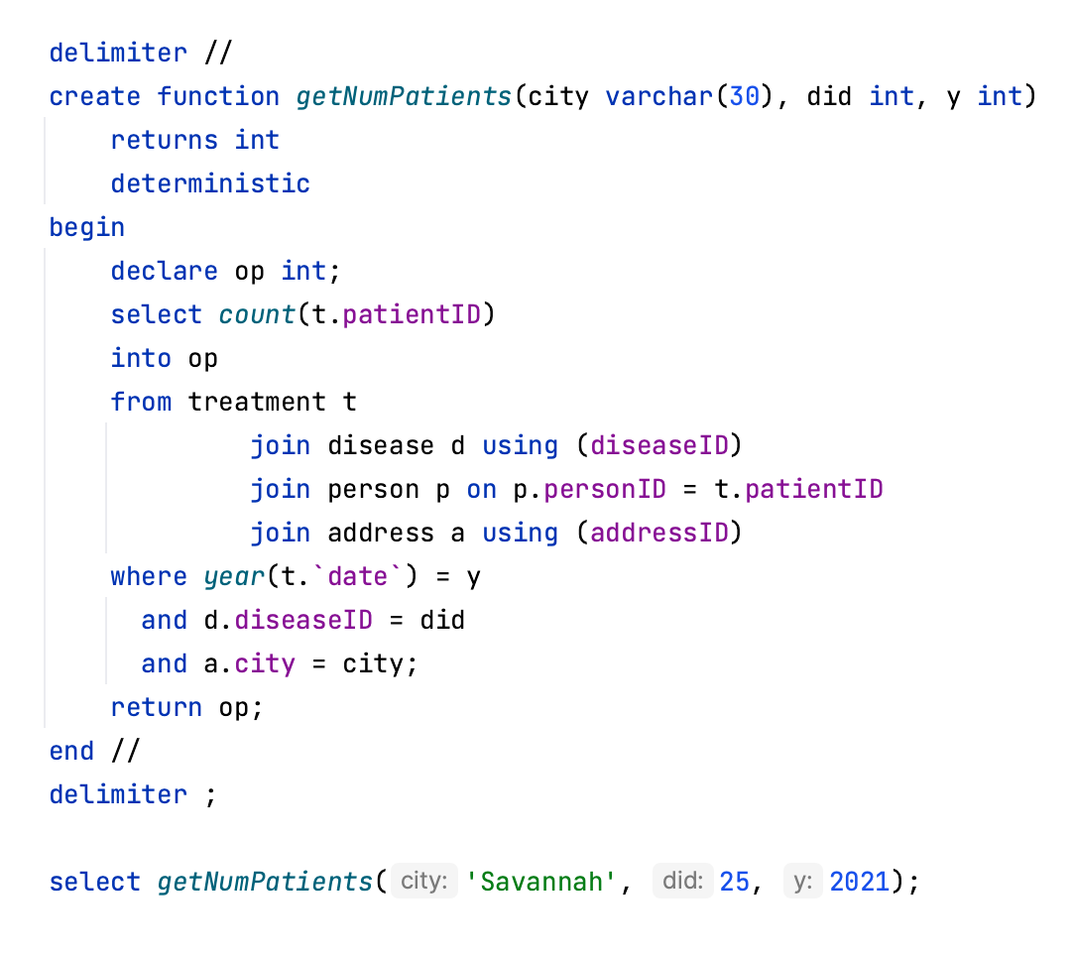

Slide 13
Sarah, from the healthcare department, has noticed many people do not claim insurance for their treatment. She has requested a state-wise report of the percentage of treatments that took place without claiming insurance. Assist Sarah by creating a report as per her requirement.

Slide 14
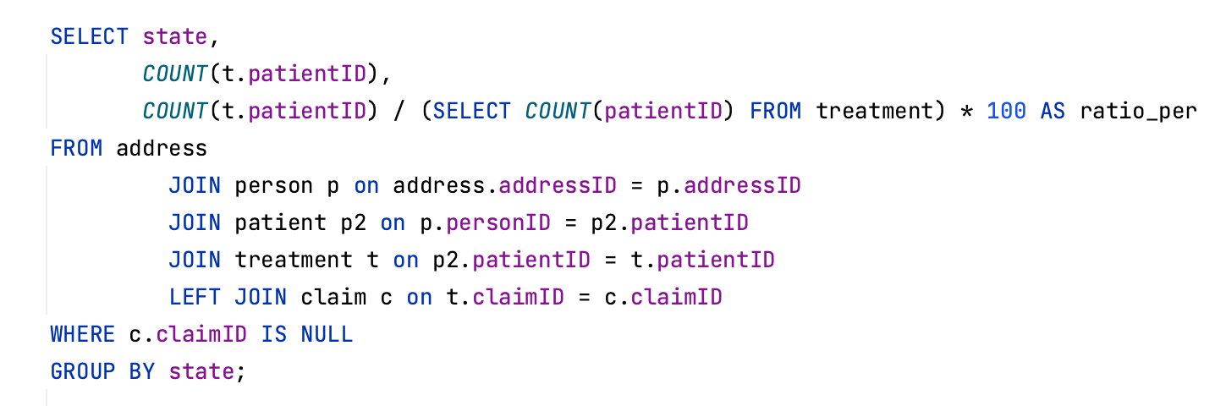

Slide 15
The healthcare department wants a pharmacy report on the percentage of hospital-exclusive medicine prescribed in the year 2022. Assist the healthcare department to view for each pharmacy, the pharmacy id, pharmacy name, total quantity of medicine prescribed in 2022, total quantity of hospital-exclusive medicine prescribed by the pharmacy in 2022, and the percentage of hospital-exclusive medicine to the total medicine prescribed in 2022. Order the result in descending order of the percentage found.

Slide 16
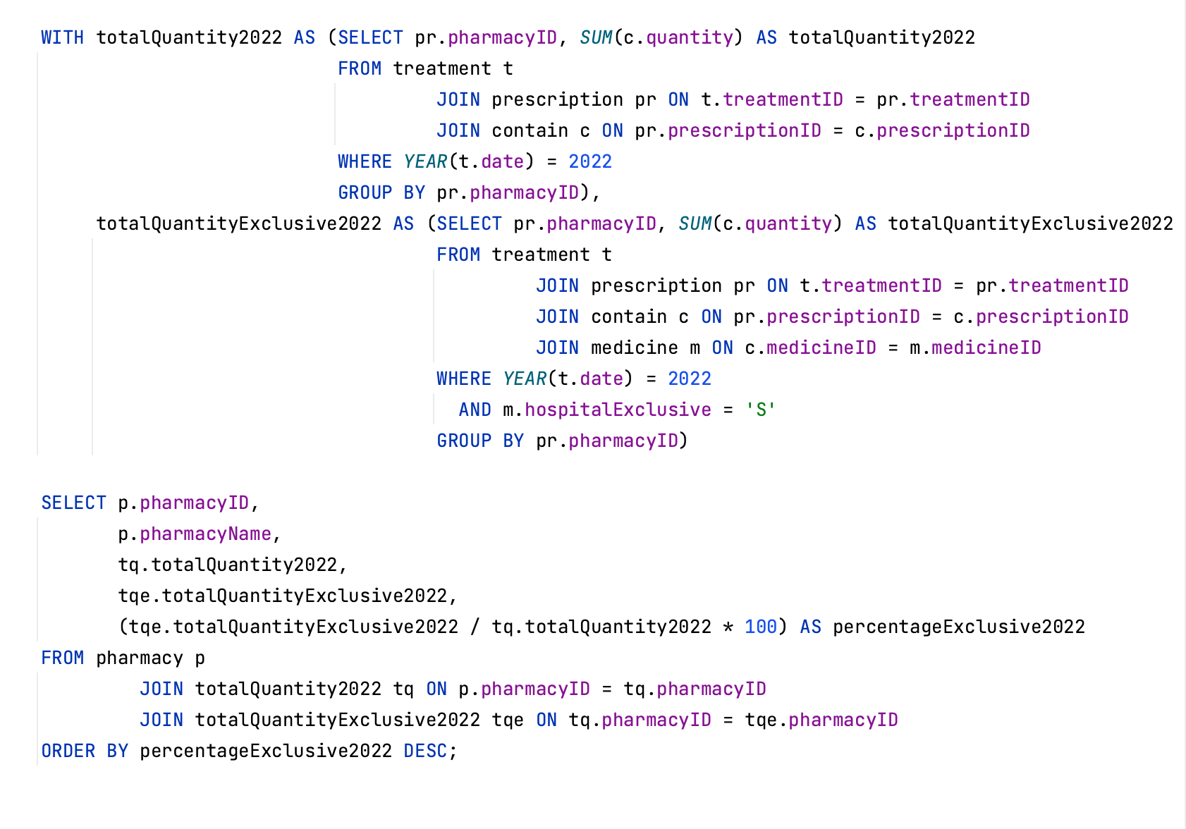

Slide 17
Thank You

